Slide 1
Financial Reporting Analytics
ACCT 5141 Fall 2021
Introduction
H. Zhang

Slide 2
Why should we learn data analytics
In general, data analytics refers to the process of examining data in order to answer questions and draw conclusions.
Gain problem solving skills
Part of data science, which is in high demand and affects almost every profession.
It's becoming more important in accounting and finance.
Data literacy/fluency is a necessary life skill.

Slide 3
Data Analytics Process
5
1
Present findings
(Domain and Stats)
Ask a question
(Domain)
4
2
Transform and Analyze data
(Coding and Stats)
Design an analysis
(Domain and Stats)
3
Acquire data
(Coding)

Slide 4
Machine Learning
?
? = Danger zone
? = Data analytics
? = Data processing

Slide 5
Danger Zone
Garbage In, Garbage Out.
Blindly rely on model predictions.
Consumer credit evaluations (poor people living in high-crime neighborhoods are subject to higher insurance premiums and more likely to be targeted by subprime loans)
Mistakenly interpret correlation as causation
Notes:
7’30

Slide 6
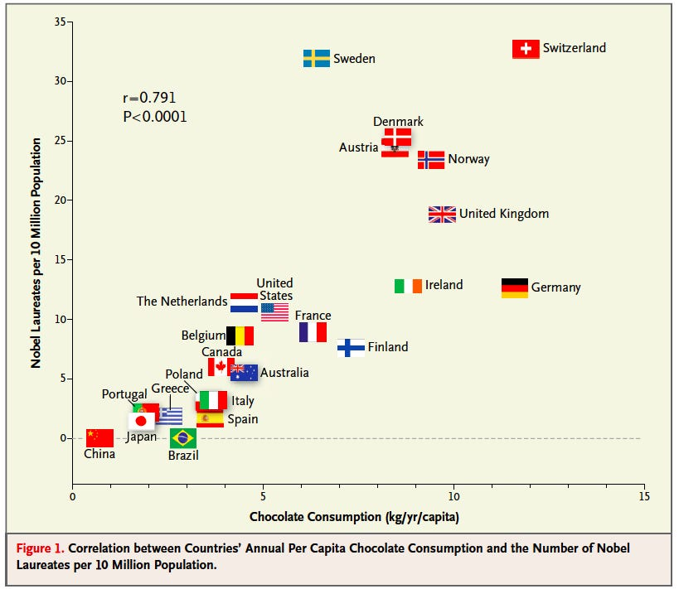

Slide 7
Simpson’s Paradox
 | DRUG | No Drug
Men | 81 of out 87 recovered (93%) | 234 out of 270 recovered (87%)
Women | 192 out of 263 recovered (73%) | 55 out of 80 recovered (69%)
Combined Data | 273 out of 350 recovered (78%) | 289 out of 350 recovered (83%)
Notes:
700 sick patents are given the option to try a new drug.

Slide 8
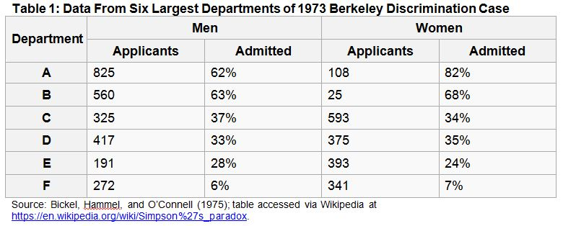
Total 2590 46% 1835 30%

Slide 9
Data Typologies and Nature of Analytics
Data typologies
Structured vs unstructured
Raw vs derived
Quantitative vs qualitative
Nature of Analytics
Description and exploration
Association
Prediction
Causation

Slide 12
Course Objectives
Get exposure to all four aspects of data science
Build quantitative analytical skills
Find out what you are interested in.
Understand the limitations of your work.
Notes:
7’30

Slide 13
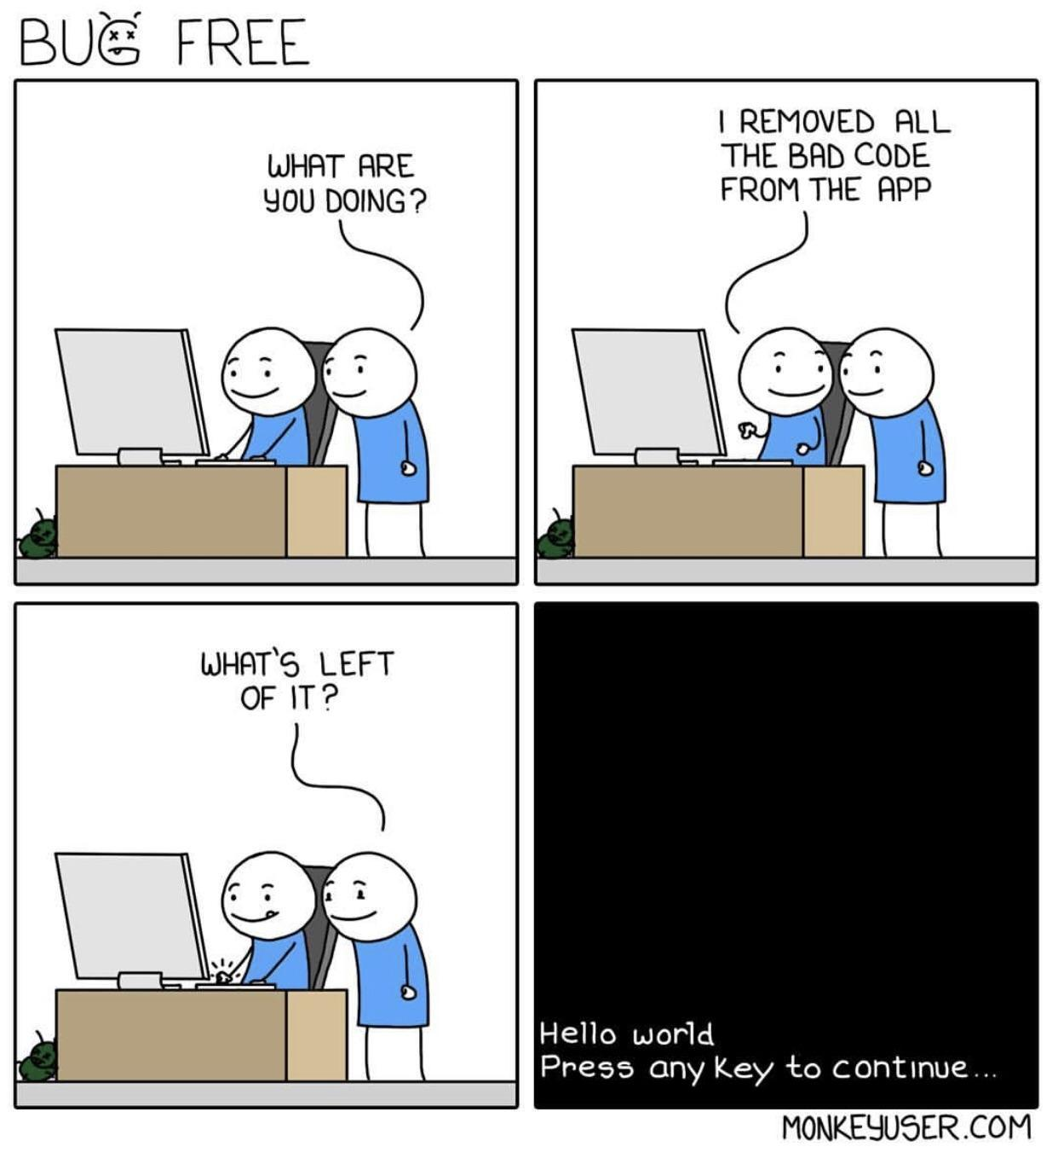
Target Audience
This course targets students who
have no prior coding experience but would like to get your hands dirty.
have some background in Business Statistics, Accounting, Finance, and General business.
are interested in financial reporting and corporate finance topics.

